Slide 1
COMP 2230
Week 10 - Monday

Slide 2
Last time
Finished binomial theorem
Probability axioms
Expected value
Conditional probability
Bayes' theorem

Slide 3
Questions?

Slide 4
Assignment 5

Slide 5
Logical warmup
Arya and Bahar went to a reception with ten other couples
Each person there shook hands with everyone he or she didn't know
Later, Bahar asked each of the other 21 partygoers how many people they shook hands with and got a different answer from each one
How many people did Arya shake hands with?

Slide 6
Back to Bayes

Slide 7
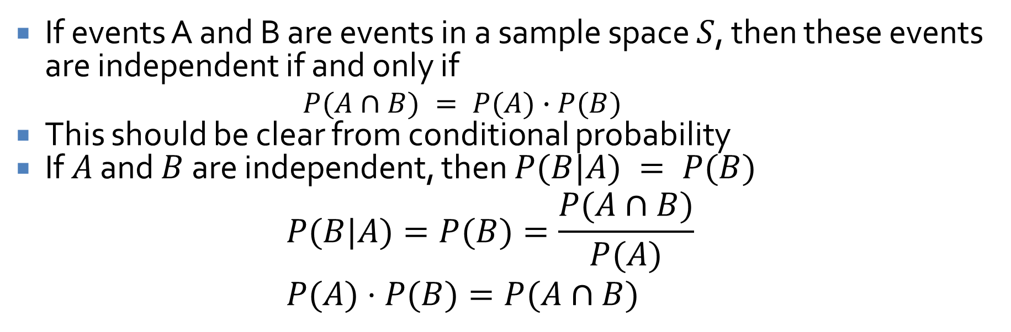
Independent events
If events A and B are events in a sample space $S$, then these events are independent if and only if
$$P(A∩B) = P(A)∙P(B)$$
This should be clear from conditional probability
If $A$ and $B$ are independent, then $P(B|A) = P(B)$
$$P(B|A)=P(B)=\frac{P(A∩B)}{P(A)} \\ P(A)⋅P(B)=P(A∩B)$$

Slide 8
Graphs: Trails, Paths, and Circuits
Three-Sentence Summary

Slide 9
Graphs

Slide 10
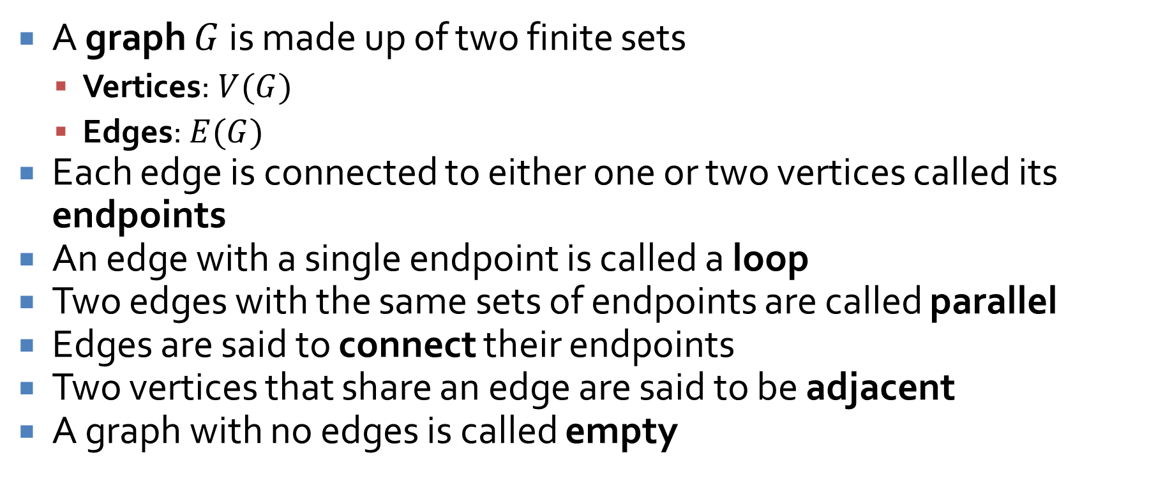
Graphs
A graph $G$ is made up of two finite sets
Vertices: $V(G)$
Edges: $E(G)$
Each edge is connected to either one or two vertices called its endpoints
An edge with a single endpoint is called a loop
Two edges with the same sets of endpoints are called parallel
Edges are said to connect their endpoints
Two vertices that share an edge are said to be adjacent
A graph with no edges is called empty

Slide 11
The purpose of graphs
Graphs can be used to represent connections between arbitrary things
Streets connecting towns
Links connecting computers in a network
Friendships between people
Enmities between people
Almost anything …

Slide 12
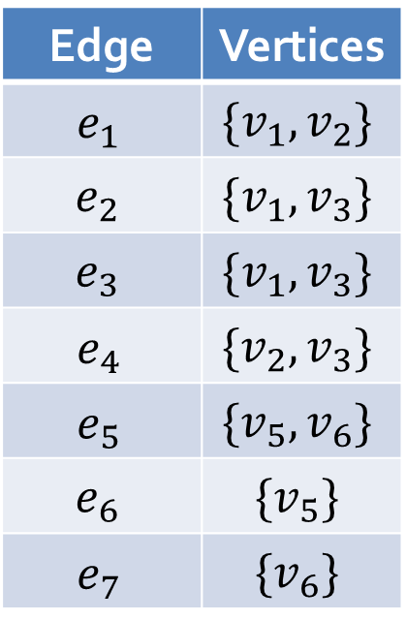
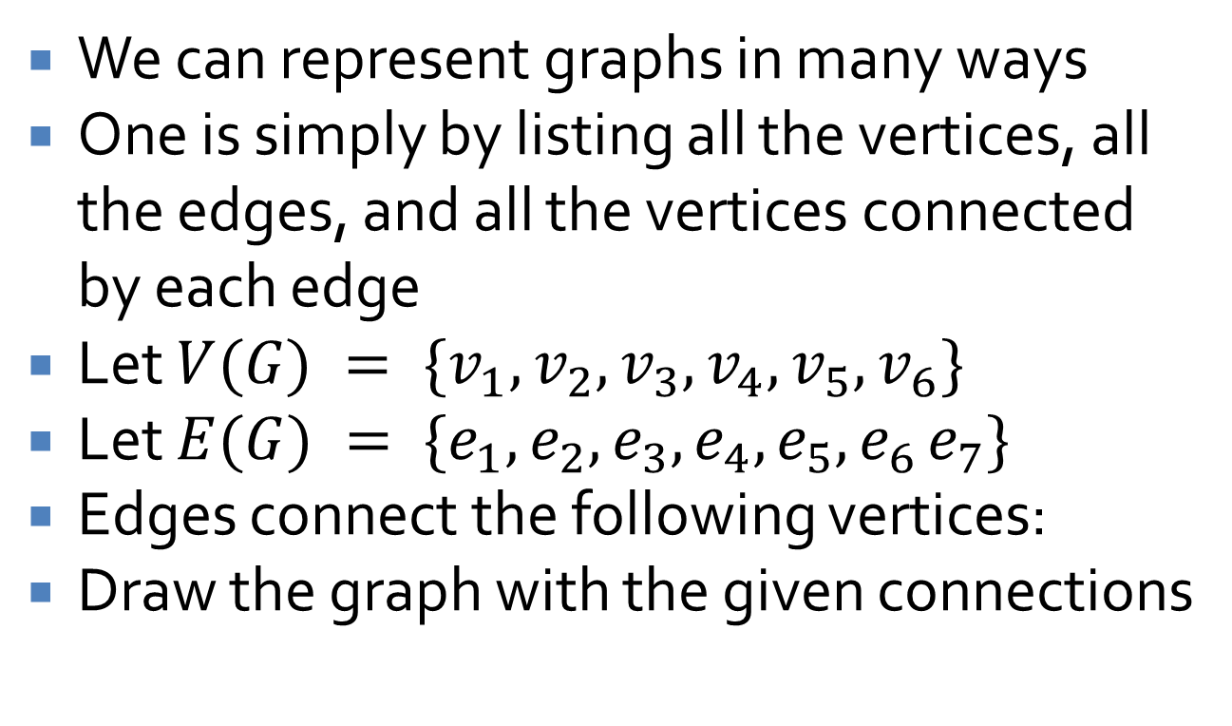
Graph representation
We can represent graphs in many ways
One is simply by listing all the vertices, all the edges, and all the vertices connected by each edge
Let $V(G) = \{v_{1}, v_{2}, v_{3}, v_{4}, v_{5}, v_{6}\}$
Let $E(G) = \{e_{1}, e_{2}, e_{3}, e_{4}, e_{5}, e_{6} e_{7}\}$
Edges connect the following vertices:
Draw the graph with the given connections
Edge | Vertices
$$e_{1}$$ | $$\{v_{1}, v_{2}\}$$
$$e_{2}$$ | $$\{v_{1}, v_{3}\}$$
$$e_{3}$$ | $$\{v_{1}, v_{3}\}$$
$$e_{4}$$ | $$\{v_{2}, v_{3}\}$$
$$e_{5}$$ | $$\{v_{5}, v_{6}\}$$
$$e_{6}$$ | $$\{v_{5}\}$$
$$e_{7}$$ | $$\{v_{6}\}$$

Slide 13
Drawing graphs
Graphs can (generally) be drawn in many different ways
We can label graphs to show that they are the same
Label these two graphs to show they are the same:

Slide 14
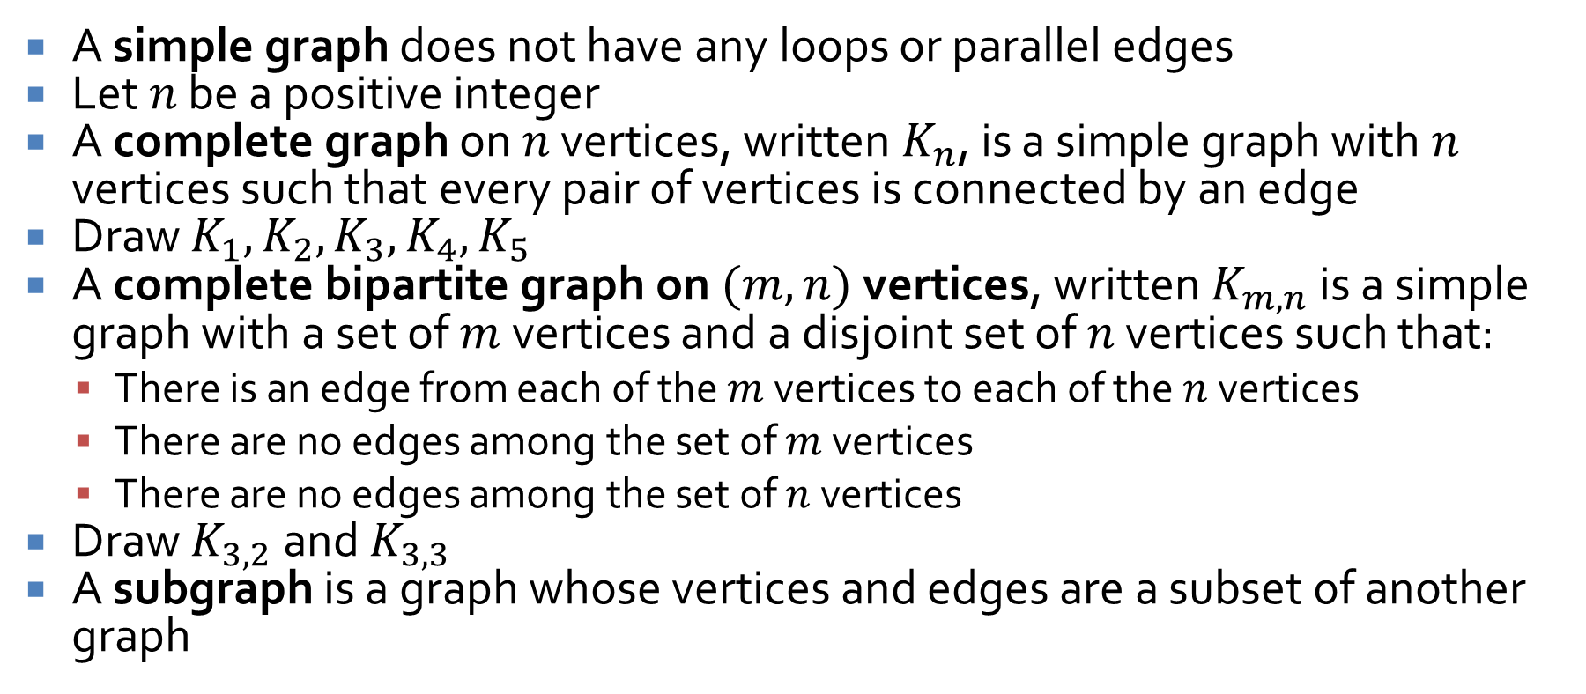
Special graphs
A simple graph does not have any loops or parallel edges
Let $n$ be a positive integer
A complete graph on $n$ vertices, written $K_{n}$, is a simple graph with $n$ vertices such that every pair of vertices is connected by an edge
Draw $K_{1}, K_{2}, K_{3}, K_{4}, K_{5}$
A complete bipartite graph on $(m, n)$ vertices, written $K_{m,n}$ is a simple graph with a set of $m$ vertices and a disjoint set of $n$ vertices such that:
There is an edge from each of the $m$ vertices to each of the $n$ vertices
There are no edges among the set of $m$ vertices
There are no edges among the set of $n$ vertices
Draw $K_{3,2}$ and $K_{3,3}$
A subgraph is a graph whose vertices and edges are a subset of another graph

Slide 15
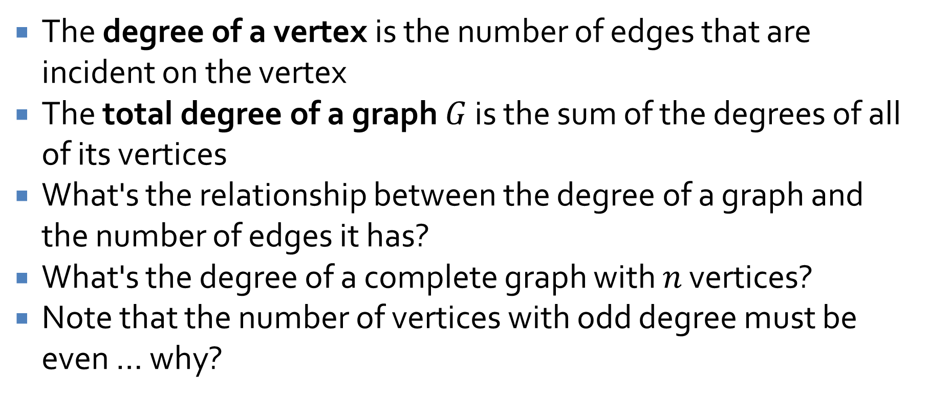
Degree
The degree of a vertex is the number of edges that are incident on the vertex
The total degree of a graph $G$ is the sum of the degrees of all of its vertices
What's the relationship between the degree of a graph and the number of edges it has?
What's the degree of a complete graph with $n$ vertices?
Note that the number of vertices with odd degree must be even … why?

Slide 16
Paths and Circuits

Slide 17
Königsberg
Used to be Königsberg, Prussia
Now called Kaliningrad, Russia
On the Pregel River, including two large islands

Slide 18
Seven Bridges of Königsberg
In 1736, the islands were connected by seven bridges
In modern times, there are only five

Slide 19
The Challenge
After a lazy Sunday and a bit of drinking, the citizens would challenge each other to walk around the city and try to find a path which crossed each bridge exactly once

Slide 20
Euler’s Solution
What did Euler find?
The same thing you did: nothing
But, he also proved it was impossible
Here’s how:
North Shore
Center
Island
East
Island
South Shore
Notes:
Remarkable for having his name mispronounced and getting a number named after himself, also knew something about civil engineering.

Slide 21
Graph Theoretical View
By simplifying the problem into a graph, the important features are clear
To arrive as many times as you leave, the degrees of each node must be even (except for the starting and ending points)
North Shore
Center
Island
East
Island
South Shore

Slide 22
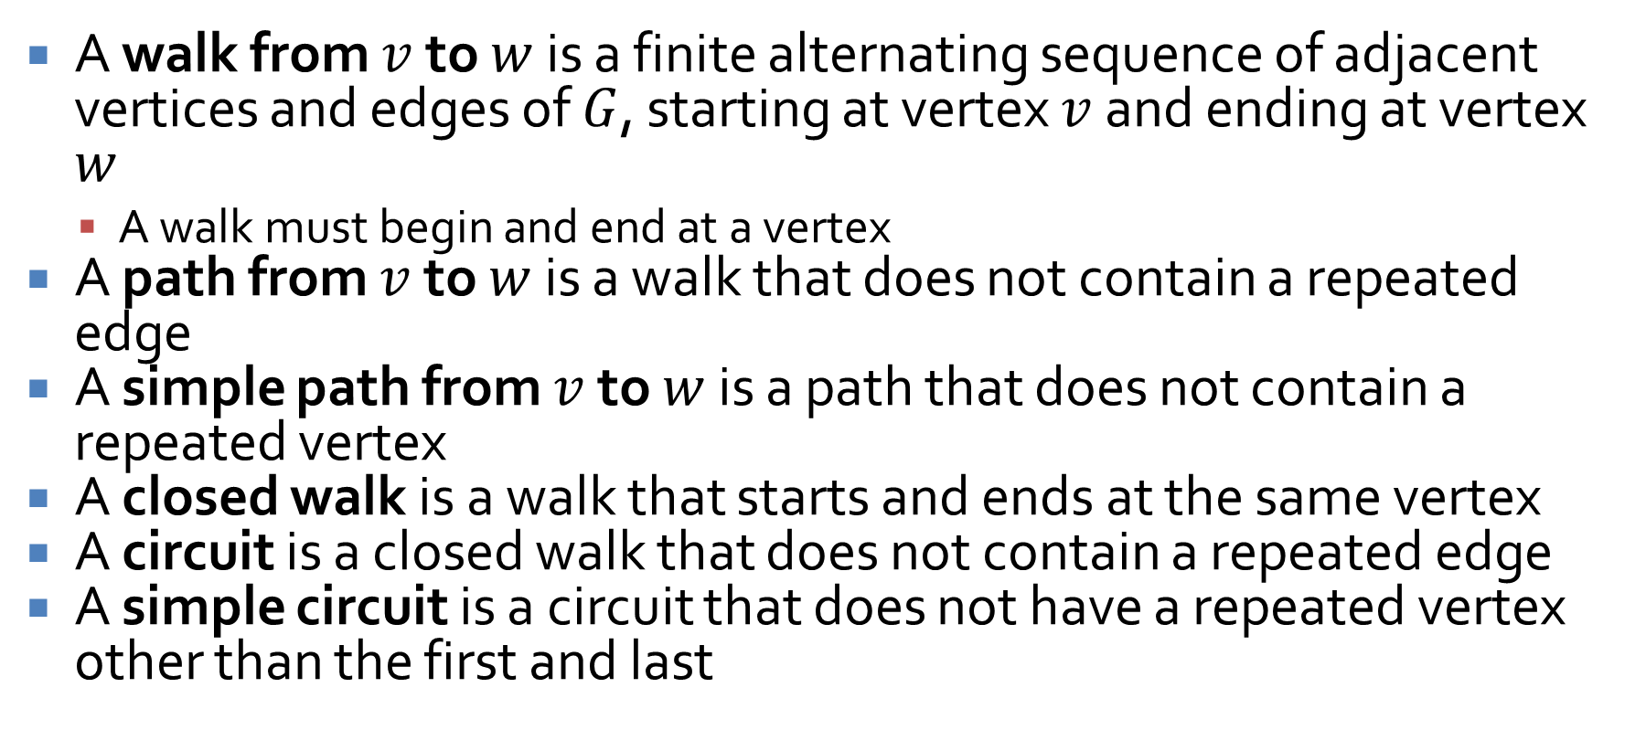
Definitions
A walk from $v$ to $w$ is a finite alternating sequence of adjacent vertices and edges of $G$, starting at vertex $v$ and ending at vertex $w$
A walk must begin and end at a vertex
A path from $v$ to $w$ is a walk that does not contain a repeated edge
A simple path from $v$ to $w$ is a path that does not contain a repeated vertex
A closed walk is a walk that starts and ends at the same vertex
A circuit is a closed walk that does not contain a repeated edge
A simple circuit is a circuit that does not have a repeated vertex other than the first and last

Slide 23



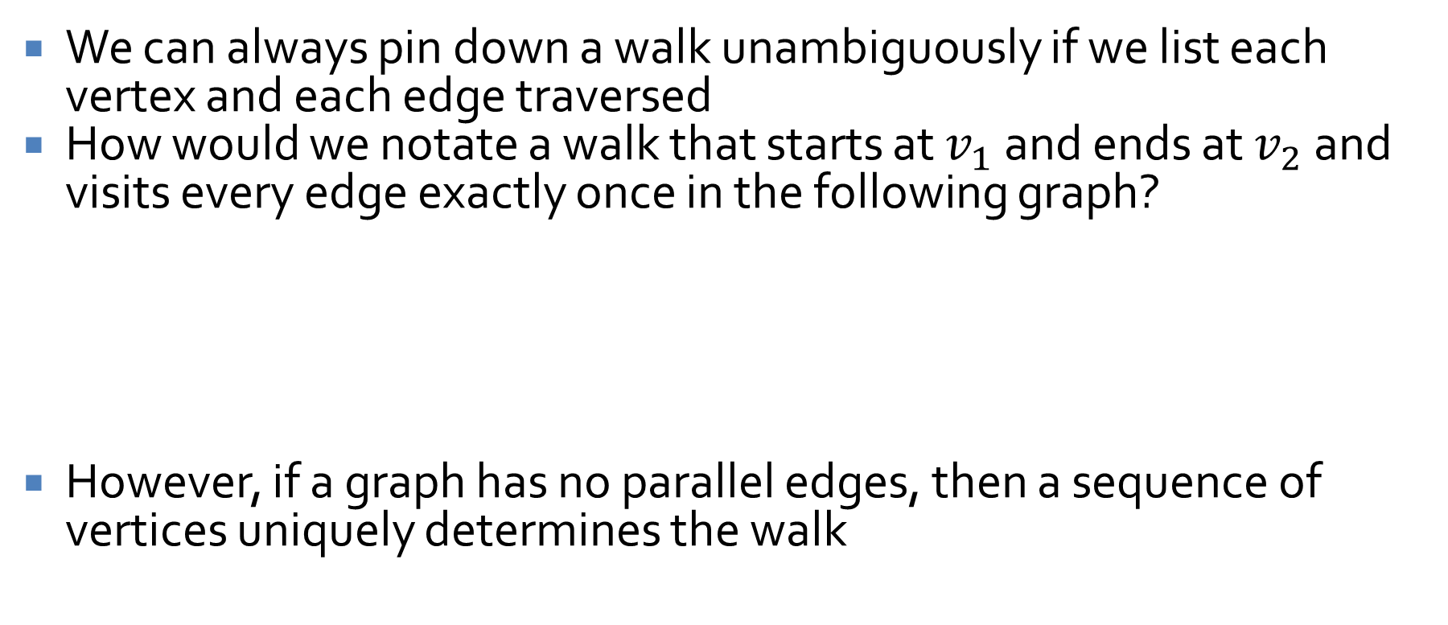




Notation
We can always pin down a walk unambiguously if we list each vertex and each edge traversed
How would we notate a walk that starts at $v_{1}$ and ends at $v_{2}$ and visits every edge exactly once in the following graph?
However, if a graph has no parallel edges, then a sequence of vertices uniquely determines the walk
$$e_{2}$$
$$e_{1}$$
$$e_{4}$$
$$v_{1}$$
$$v_{2}$$
$$v_{3}$$
$$e_{3}$$

Slide 24
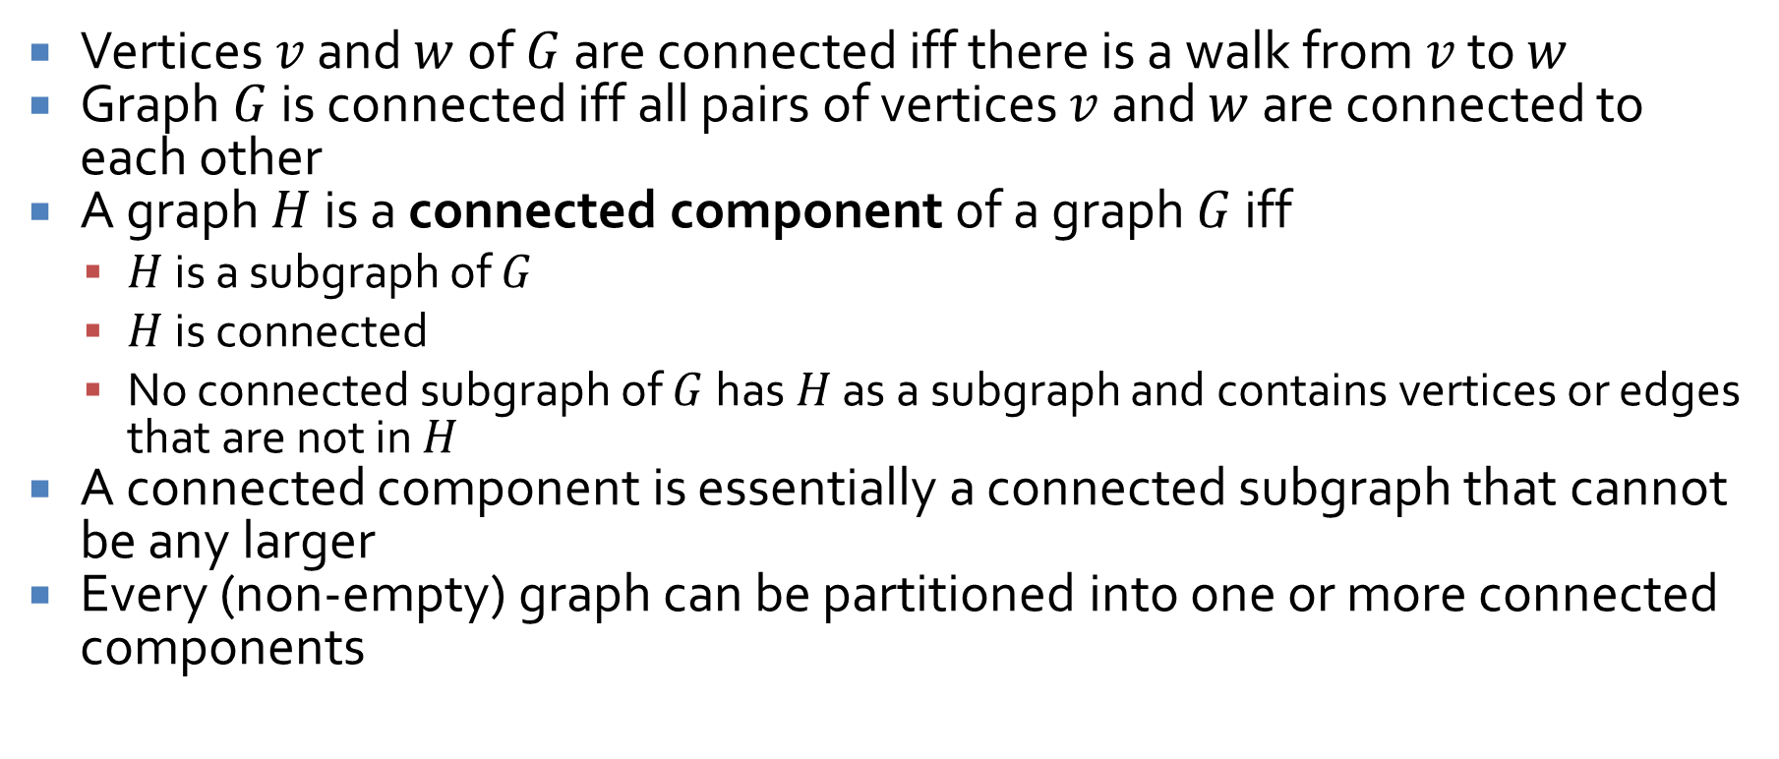
Connectedness
Vertices $v$ and $w$ of $G$ are connected iff there is a walk from $v$ to $w$
Graph $G$ is connected iff all pairs of vertices $v$ and $w$ are connected to each other
A graph $H$ is a connected component of a graph $G$ iff
$H$ is a subgraph of $G$
$H$ is connected
No connected subgraph of $G$ has $H$ as a subgraph and contains vertices or edges that are not in $H$
A connected component is essentially a connected subgraph that cannot be any larger
Every (non-empty) graph can be partitioned into one or more connected components

Slide 25
Euler circuits
What if you want to find an Euler circuit of your own?
If a graph is connected, non-empty, and every node in the graph has even degree, the graph has an Euler circuit
Algorithm to find one:
Pick an arbitrary starting vertex
Move to an adjacent vertex and remove the edge you cross from the graph
Whenever you choose such a vertex, pick an edge that will not disconnected the graph
If there are still uncrossed edges, go back to Step 2

Slide 26


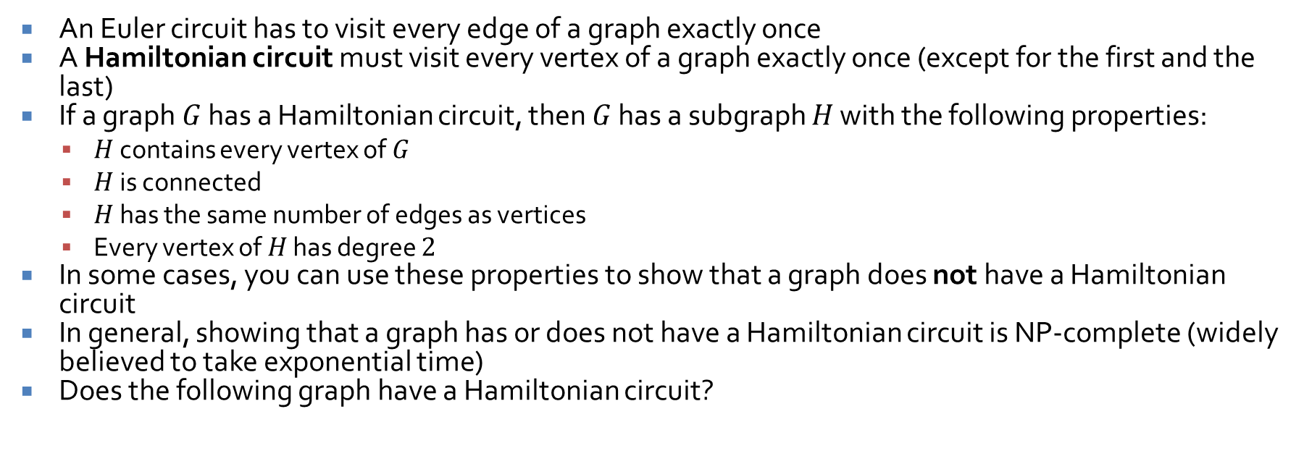



Hamiltonian circuits
An Euler circuit has to visit every edge of a graph exactly once
A Hamiltonian circuit must visit every vertex of a graph exactly once (except for the first and the last)
If a graph $G$ has a Hamiltonian circuit, then $G$ has a subgraph $H$ with the following properties:
$H$ contains every vertex of $G$
$H$ is connected
$H$ has the same number of edges as vertices
Every vertex of $H$ has degree $2$
In some cases, you can use these properties to show that a graph does not have a Hamiltonian circuit
In general, showing that a graph has or does not have a Hamiltonian circuit is NP-complete (widely believed to take exponential time)
Does the following graph have a Hamiltonian circuit?
$$a$$
$$c$$
$$b$$
$$e$$
$$d$$

Slide 27
Upcoming

Slide 28
Next time…
Matrix representation
Isomorphisms

Slide 29
Reminders
Start Assignment 5
Read 10.2 and 10.3
Prepare a three-sentence summary
Extra credit if you get called on

